Slide 1


N.B.K.R.INSTITUTE OF SCIENCE & TECHNOLOGY
Sorghu-Shield: Eco Food Packaging
BATCH NO :-1
P.RENUKA (24KB1A3086)
K.HARSHITHA(24KB1A3046)
SK.LIMRA(24KB1A3098)
K.YASASWANI LALITHA(24KB1A3052)

Slide 2

Introduction :-
CONTEXT FOR ECO PACKAGING
The growing plastic pollution problem necessitates sustainable solutions. Eco-friendly packaging is vital for the food industry to reduce environmental impact.
Problem Statement - Plastic causes pollution - Existing packaging fails with hot food - Need eco-friendly solution
Solution / Idea - Use sweet sorghum bagasse - Biodegradable, strong, leak-proof - Replaces plastic containers

Slide 3

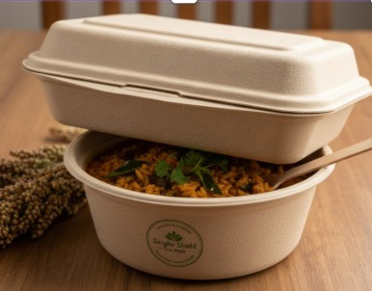
Challenges with Current Packaging
PLASTIC
PAPER
Plastic materials cause severe environmental damage, contributing to pollution and harming wildlife in ecosystems around the world.
Traditional paper products often leak when used with hot food, limiting their usability and effectiveness in the food industry.
ALTERNATIVES
There is a significant lack of strong, biodegradable alternatives in the market, creating a need for innovative packaging solutions.

Slide 4
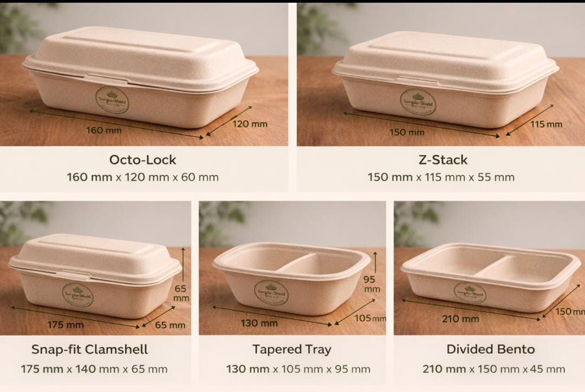
Introducing Sorghu-Shield: Sustainable Packaging Solution
ECO-FRIENDLY AND BIODEGRADABLE
Sorghu-Shield utilizes sweet sorghum bagasse to create strong, leak-proof containers, offering a sustainable alternative to conventional plastic packaging.

Slide 5
Unique Features
INNOVATION
BIODEGRADABILITY
TECHNOLOGY
Sorghu-Shield represents novel innovation in eco-packaging through the use of sustainable sorghum fiber, reducing reliance on traditional materials.
Fully biodegradable and compostable, Sorghu-Shield packaging contributes to a sustainable waste management system, supporting environmental goals effectively.
The application of high-temperature hot pressing technology enhances the strength and durability of packaging, ensuring it meets food safety standards.

Slide 6
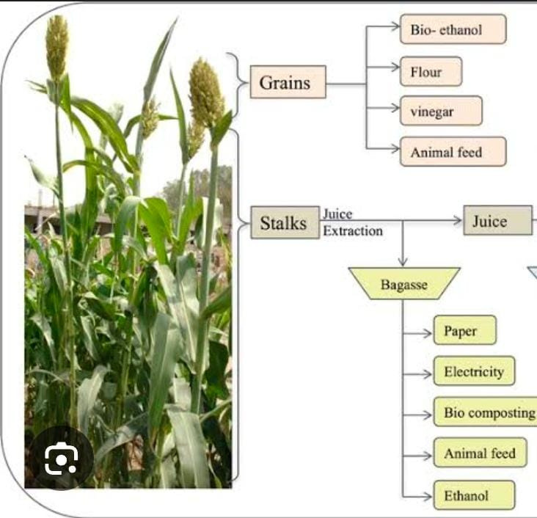
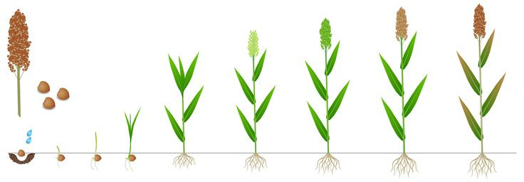
Sweet Sorghum Stalk
STRONG AND SUSTAINABLE RAW MATERIAL SOURCE
The outer stalk of sweet sorghum is a robust fiber source ideal for eco-friendly packaging. With a growth cycle of 120–135 days,
It requires moderate water supply, making it suitable for regions like Andhra Pradesh, where its availability aligns with local agricultural practices.

Slide 7
Manufacturing Process
MATERIAL SOURCING
CLEANING PROCESS
PACKAGING FORMATION
Sourcing sweet sorghum for sustainable production.
Thoroughly cleaning sorghum to ensure quality.
Molding and shaping into final product containers.

Slide 8
Key Manufacturing Steps of Sorghu-Shield
1. Raw Material Collection
↓
2. Cleaning & Drying
↓
3. Crushing / Size Reduction
↓
4. Pulping (Fiber + Water Mixing)
↓
5. Screening & Refining
↓
6. Molding / Forming (Shape Creation)
↓
7. Vacuum Dewatering
↓
8. Hot Pressing (High Temperature & Pressure)
↓
9. Trimming & Finishing
↓
10. Sterilization (Heat / UV Treatment)
↓
11. Quality Checking
↓
12. Packing & Storage
UNDERSTANDING THE PRODUCTION PROCESS
The manufacturing process includes pulping, forming, hot pressing, and sterilization, ensuring that our containers remain safe and durable for all food types.
Pulping: fiber + water mix
- Forming: shape creation
- Hot pressing: strength
- Sterilization: food safety

Slide 9
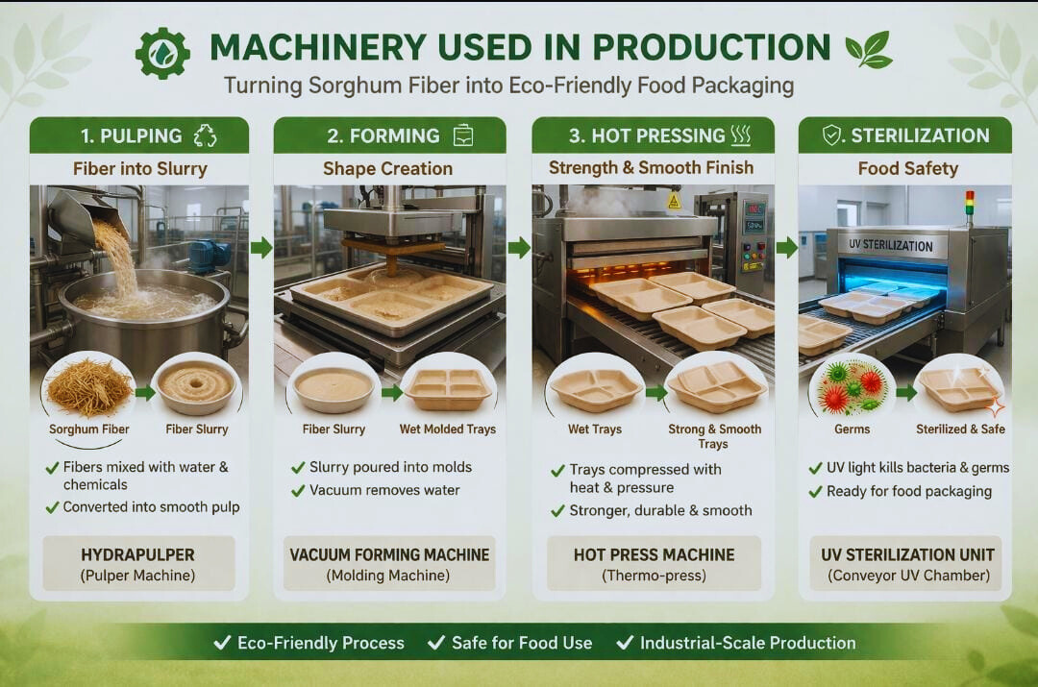

Slide 10
Advantages of Sorghu-Shield
ECO-FRIENDLY
LEAK-PROOF
COST-EFFECTIVE
Sorghu-Shield is made from renewable materials, ensuring a minimal environmental footprint and supporting sustainable practices in food packaging.
Designed to be leak-proof, Sorghu-Shield containers can hold hot, liquid foods without compromising integrity, ensuring customer satisfaction.
With a production cost of ₹1.90 per box, Sorghu-Shield offers a budget-friendly alternative to traditional packaging options, enhancing profitability.

Slide 11
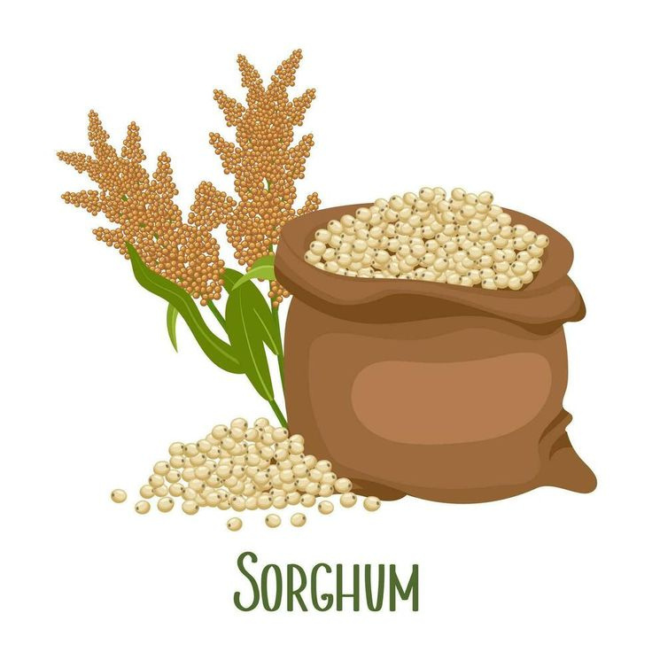
Comparing Sorghum Packaging with Alternatives
MATERIAL STRENGTH AND ENVIRONMENTAL IMPACT
Sorghu-Shield packaging outperforms traditional materials like plastic and paper in strength, leak-proof capabilities, and eco-friendliness while being cost-effective.

Slide 12
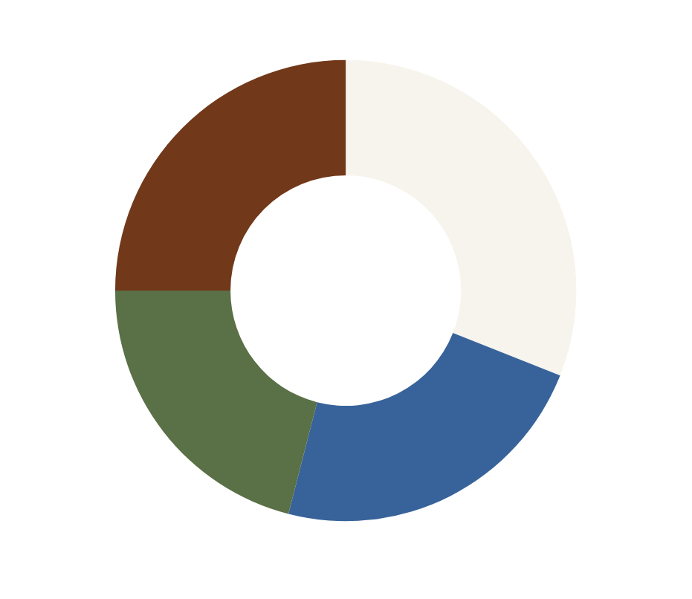
Cost Comparison of Eco Packaging
The chart illustrates the cost-effectiveness of Sorghu-Shield packaging compared to alternatives. Sorghu-Shield emerges as the most affordable option, promoting sustainability without compromising quality.
Cost Comparison of Sorghum Packaging Against Alternatives

Slide 13
Waste Management Insights
WASTE GENERATION
Our process generates only 8–15% waste, making it an efficient option for eco-friendly production without compromising on quality.
RECYCLING RATE
WATER REUSE
With a 90–95% recycling rate, we ensure that most of our materials are repurposed, significantly reducing environmental impact.
We implement a water reuse strategy, allowing us to recycle water within the production process, conserving this vital resource effectively.

Slide 14

₹1.10
PROFIT PER BOX
The profit per box for Sorghu-Shield packaging is ₹1.10. This indicates a strong financial performance, highlighting the potential for sustainable packaging solutions to be both eco-friendly and economically viable. As the demand for green packaging rises, profitability is expected to improve even further.
Selling price: ₹3.00
Profit: ₹1.10
Profit margin: 36–37%

Slide 15
Production and Break-Even
PROFIT
VOLUME
TIMELINE
The monthly profit is projected to reach ₹55,000, demonstrating the financial viability and sustainability of our product.
We plan to produce 50,000 boxes per month, meeting the rising demand for eco-friendly packaging in the food industry.
The estimated break-even point is approximately 14 months, making Sorghu-Shield a promising investment opportunity for stakeholders.

Slide 16

Future Potential of Eco-Friendly Packaging Solutions
TRENDS IN MARKET GROWTH
The demand for sustainable packaging solutions is rising significantly, driven by consumer awareness and government initiatives against plastic pollution. Increasing demand for eco-products - Government plastic ban support - Expansion to food industry
Conclusion: - Sustainable alternative to plastic - Profitable business model - Future-ready innovation

